Slide 1

CMSC 137
Data Communications and Networking
Lecture Module
13 – Data Link Control

Slide 2
Module 13: Data Link Control
Rozano S. Maniaol
Lecturer

Slide 3
Framing

Slide 4
Framing
Separates a message from one source to destination, or from other messages to other destinations by adding a sender address and a destination address
Destination address tells where the frame is to go
Sender address helps the recipient acknowledge the receipt
A very large frame makes flow and error control very inefficient – a single bit error requires re-transmission

Slide 5
Framing
Fixed-size framing – no need to define boundaries of the frames; ex. ATM networks
Variable-size framing – need to define the end of the frame and beginning of the next; used in most networks
  Character-oriented
  Bit-oriented

Slide 6

Character-oriented Framing
Data to be carried are 8-bit characters from a coding system such as ASCII
Header and trailer are multiples of 8 bits
8-bit (1 byte) flag is added at the beginning and end of a frame

Slide 7
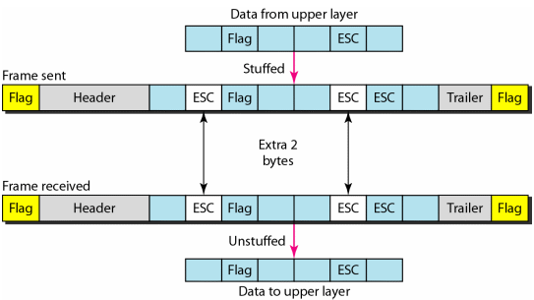
Character-oriented Framing
Byte-Stuffing - Prevents data from being interpreted as flag
A special byte, called escape character (ESC), is added to the data section of the frame when there is a character with the same pattern as the flag

Slide 8

Bit-oriented Framing
Data section of frame is a sequence of bits to be interpreted by the upper layer as text, graphic, audio, video, etc.
Delimiter is a special bit pattern: 01111110

Slide 9
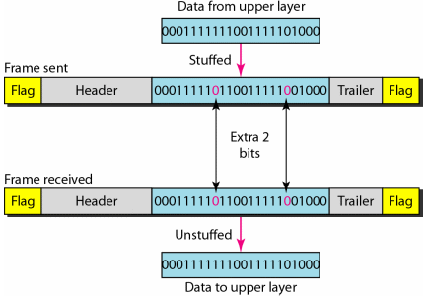
Bit-oriented Framing
Adds one extra 0 whenever five consecutive 1s follow a 0 in the data

Slide 10
Flow and Error Control

Slide 11
Flow and Error Control
Flow control coordinates the amount of data that can be sent before receiving an acknowledgment
Error control is both error detection and correction
Automatic Repeat Request (ARQ) – any time an error is detected in an exchange, specified frames are re-transmitted

Slide 12
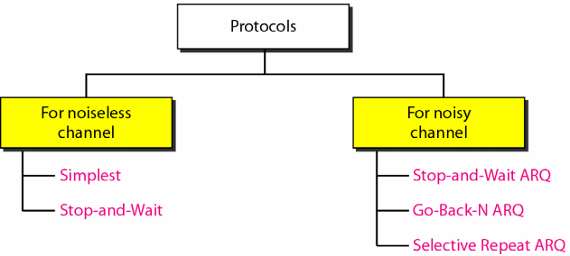
Protocols

Slide 13
Protocols
Note that the examples’ focus are on unidirectional transfer
Specialized frames
  ACK – acknowledgment
  NAK – negative acknowledgment
Piggybacking – NAKs and ACKs included in the data frame
Implemented in software

Slide 14
Simplest Protocol
Sender
Receiver
Request
Frame
Arrival
Request
Frame
Arrival
Request
Frame
Arrival
Time
Time

Slide 15
Stop and Wait Protocol
If the data frames arrive at the receiver site faster than they can be processed, the frames must be stored until their use
Sender sends one frame, until it receives confirmation from the receiver and then sends next frame

Slide 16
Stop and Wait Protocol
Sender
Receiver
Request
Frame
Arrival
ACK
Arrival
Request
Frame
Arrival
ACK
Arrival
Time
Time

Slide 17
Stop and Wait ARQ
Adds redundancy bits to data frame
At the receiver end, if a frame is corrupted, it is silently discarded
Numbering frames (sequence numbers) allows detection of lost frames
Corrupted and lost frames must be resent
Sender maintains a copy of sent frame and starts a timer
If timer expires and no ACK received, resend
ACK frames can also be corrupted

Slide 18
Stop and Wait ARQ
Sequence numbers
  Select the smallest range that provides unambiguous communication; also to minimize frame size
  If m bits long, sequence number start from 0 to 2^{m}-1 and then are repeated
Acknowledgment numbers
  Announces the next sequence number expected
In Stop-and-Wait ARQ, the sequence number and acknowledgment number are based on modulo-2 arithmetic

Slide 19
Stop and Wait ARQ
S_{n}
Sender
Receiver
0
Start
Request
0
1
0
1
0
1
R_{n}
Frame 0
0
1
1
0
1
0
1
Arrival
S_{n}
ACK 1
0
0
1
1
1
0
0
1
1
0
0
1
Stop
Arrival
1
S_{n}
Start
Request
0
1
0
1
0
1
Frame 1
Lost
S_{n}
Timeout
Restart
R_{n}
Timeout
0
1
0
1
0
1
Frame 1 (resent)
0
0
1
1
0
0
0
1
1
0
0
1
1
Arrival
S_{n}
ACK 0
0
0
1
1
0
0
0
1
1
0
0
1
Stop
Arrival
1
Time
Time

Slide 20
Stop and Wait ARQ
Sender
Receiver
S_{n}
Start
Request
0
1
0
R_{n}
0
1
0
1
Frame 0
0
0
1
1
0
0
0
1
1
0
0
1
1
Arrival
ACK 1
Lost
S_{n}
Timeout
Restart
0
1
0
Timeout
0
1
0
1
Frame 0 (resent)
R_{n}
0
1
0
1
0
1
Arrival
S_{n}
ACK 1
duplicate
discard
0
0
1
1
0
0
0
1
1
0
0
1
Stop
Arrival
1
Time
Time

Slide 21
Stop and Wait ARQ
Inefficient if channel is thick and long: large bandwidth and round-trip delay is long
Recall: bandwidth-delay product (BDP) – volume of pipe in bits
BDP is a measure of the number of bits we can send out of our system while waiting for news from the receiver

Slide 22
Go-Back-N ARQ
Multiple frames must be in transit while waiting for ACK - pipelining
We keep a copy of the frames in transit until acknowledgment arrives
Sequence numbers are modulo 2^{m}, where m is the size of the sequence number field in bits
ACKs are cumulative – more than one frame can be acknowledged by a single ACK

Slide 23
Go-Back-N ARQ
Sliding Window
  Abstract concept that defines the range of sequence numbers that is the concern of the sender and receiver
Send Sliding Window
  Imaginary box covering the sequence numbers of the data frames which can be in transit
  Can slide one or more slots when a valid acknowledgment arrives
Receive Sliding Window
  Imaginary box of size 1
  The window slides when a correct frame has arrived; sliding one slot at a time

Slide 24
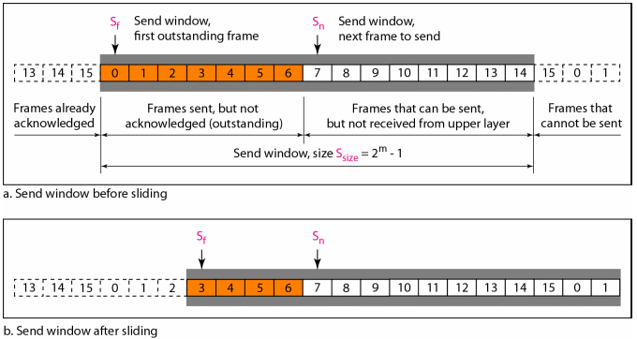
Go-Back-N ARQ
Send window for Go-Back-N ARQ; S_{f}, S_{n},S_{size}

Slide 25
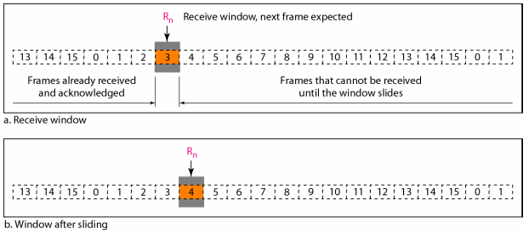
Go-Back-N ARQ
Receive window for Go-Back-N ARQ; R_{n}

Slide 26
Go-Back-N ARQ
Only one timer is used since the first outstanding frames always expires first
Silence of receiver cause the timer of the unacknowledged frame at the sender site to expire
Sender re-sends all outstanding frames
Ex. Sender has already sent frame 6, but timer for frame 3 expires. Sender must resend 3,4,5,6

Slide 27
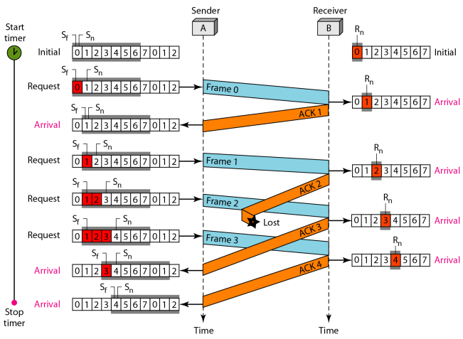
Go-Back-N ARQ
Forward channel is reliable

Slide 28
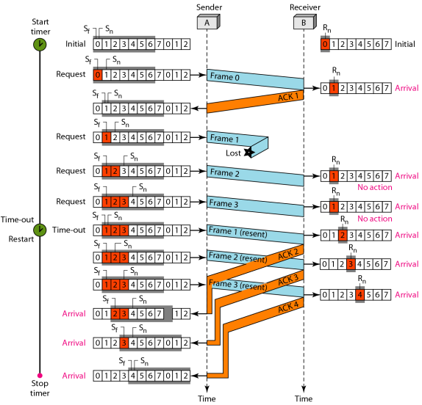
Go-Back-N ARQ
Lost Frames
Stop-and-Wait ARQ is a special case of GBN ARQ with send window size of 1

Slide 29
Selective Repeat ARQ
Only damaged frames are resent
More efficient for noisy links
Processing at the receiver is more complex
Send window max size is 2^{m-1}; same size in receive window;smaller than GBN
  Less efficient but fewer duplicate frames

Slide 30
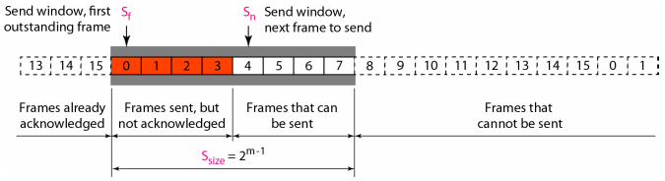
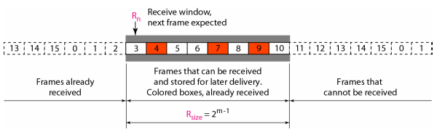
Selective Repeat ARQ
Send Window
Receive Window

Slide 31
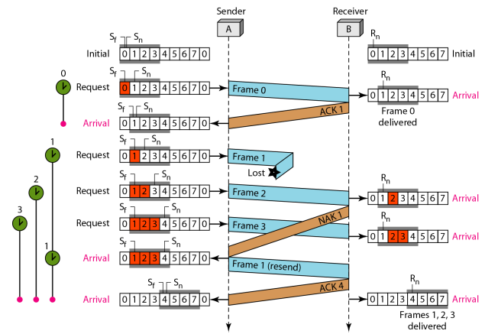
Selective Repeat ARQ

Slide 32
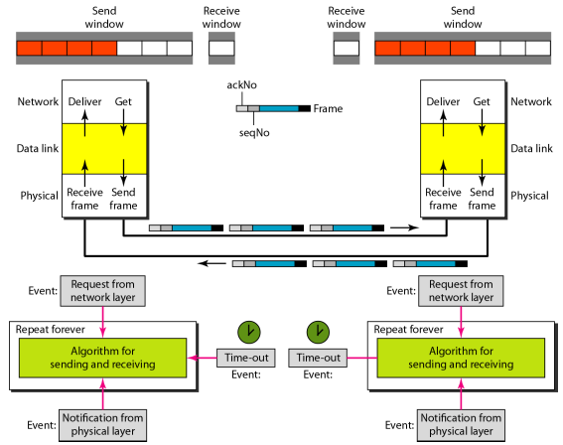
Piggybacking in Go-Back-N ARQ

Slide 33
References
Forouzan, B.A. 2013. Data Communications and Networking, 5th Ed. McGraw-Hill, New York.

